Slide 1
Iterators – An Overview
Under the guidance of Dr. Rajeev Raje
Abhinandan Jayanth , Akshay Virkud, Arvind Nair,
Hitendra Rathod and Pulkit Sood

Slide 2
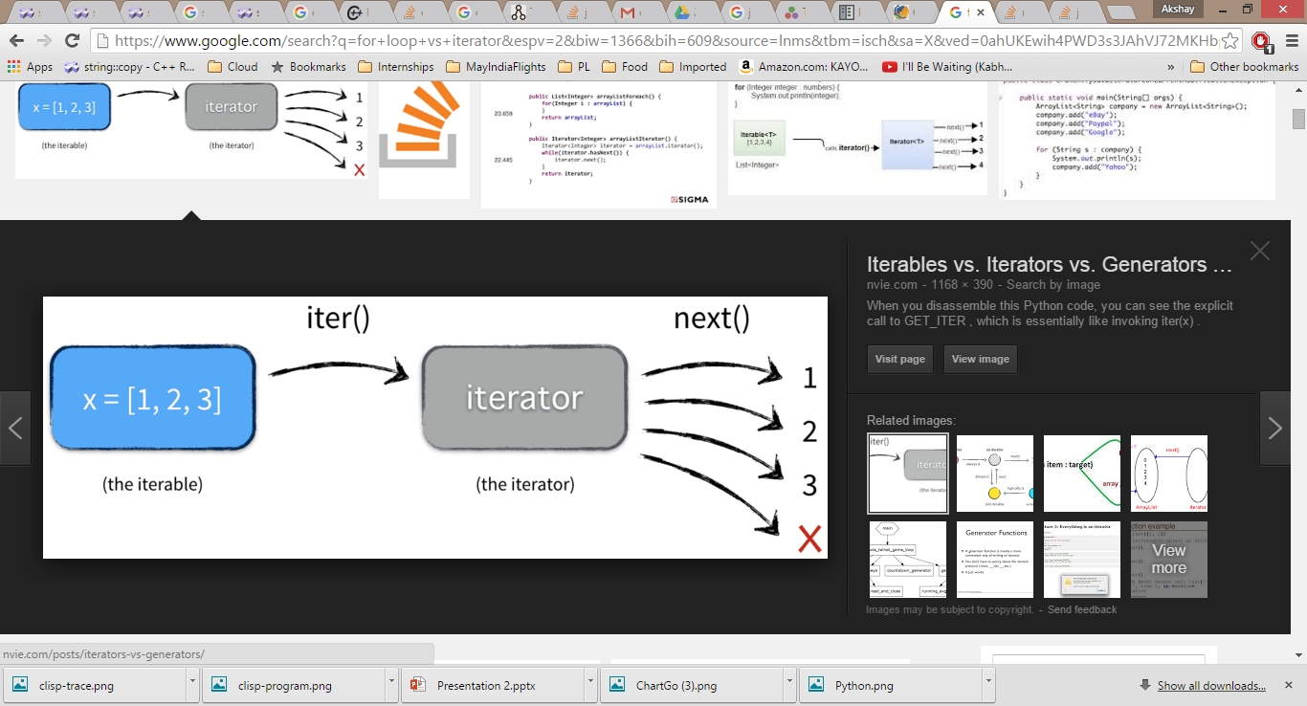
What is an Iterator?
“An iterator is a module that allows clients to access each element of a composite data type while hiding the representation of the structure.” – David Alex Lamb _{[Senior Member, IEEE]}
In computer programming, an iterator is an object that enables a programmer to traverse a container, particularly lists.
Various types of iterators are often provided via a container's interface.
An iterator is behaviorally similar to a database cursor.

Slide 3
Benefits of Iterators
Decoupling of data and algorithm leading to reuse.
Iterators allow access to large lists in an efficient manner.
Iterators store execution state.
A single iterator interface can be used for multiple containers.

Slide 4
Types of Iterators
Iterators can be classified into two broad categories on the basis of:
Access
Operations
On the basis of access there are two sub-categories:
1. Read-only access
2. Read-Write access

Slide 5
Types of Iterators…
On the basis of Operations there are the following categories:
Input Iterators
Output Iterators
Bidirectional Iterators
Random Access Iterators
Forward Iterators
Reverse Iterators

Slide 6
Application of Iterators in Good Software Practices
Open Closed Principle
Modularity
Separation of Concerns
Abstraction
Anticipation of Changes
Generality
Incremental Development
Consistency
Iterator Pattern

Slide 7

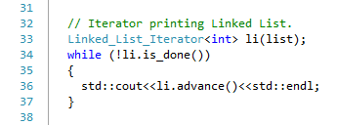
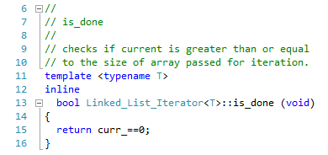
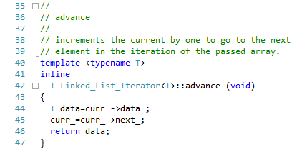
Simulation in C++ (Code)
Retrieving elements using Get in For-Loop.
Complexity of Loop : O(n)
Complexity of Get : O(n)
Hence Both combined : O(n²)
Retrieving elements using Iterator.
Complexity is O(n) as it stores and uses the reference of the previous object to access the next object.

Slide 8
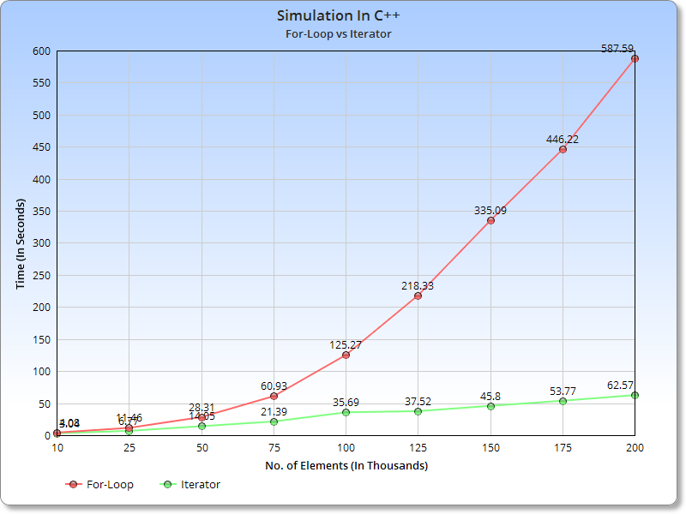
Simulation in C++ (Graph)

Slide 9
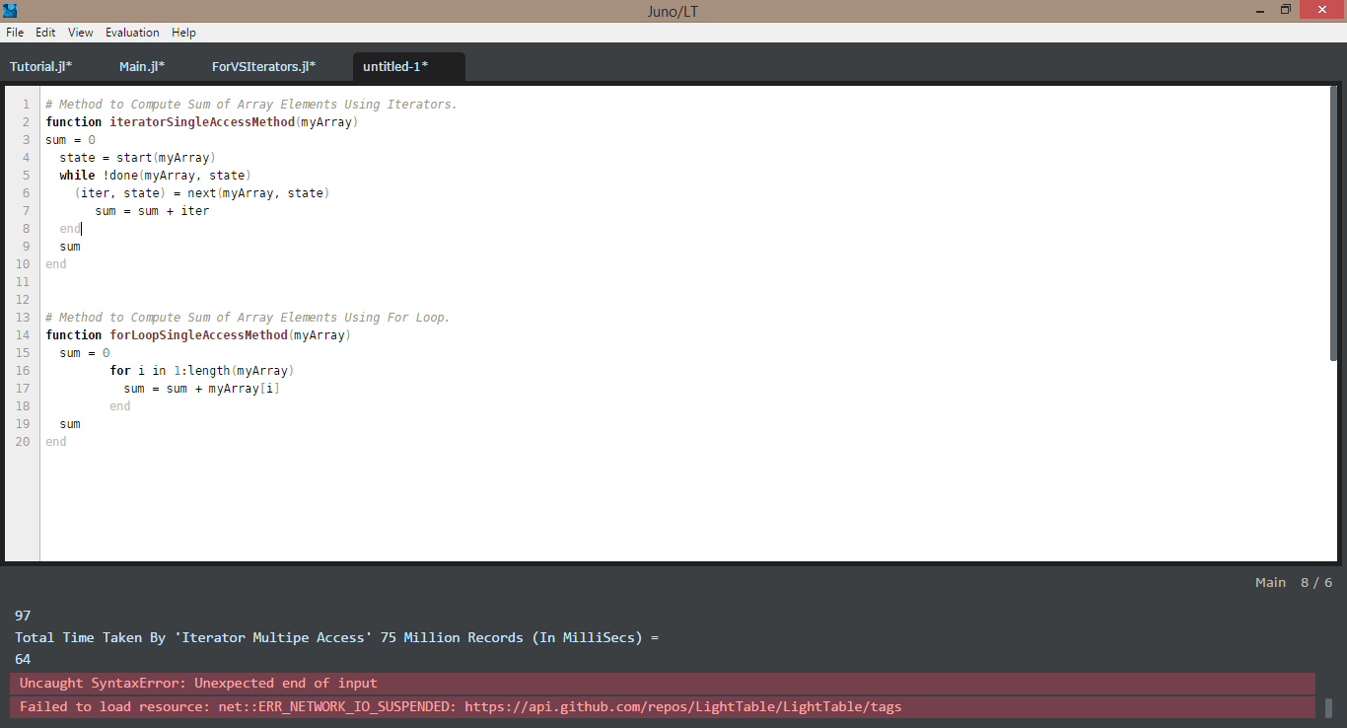

Simulation in Julia (Code)
Julia is a high-level, high-performance dynamic programming language for technical computing, founded in 2012.
Calculating Sum of Array Using For-Loop
Calculating Sum of Array Using Iterator

Slide 10
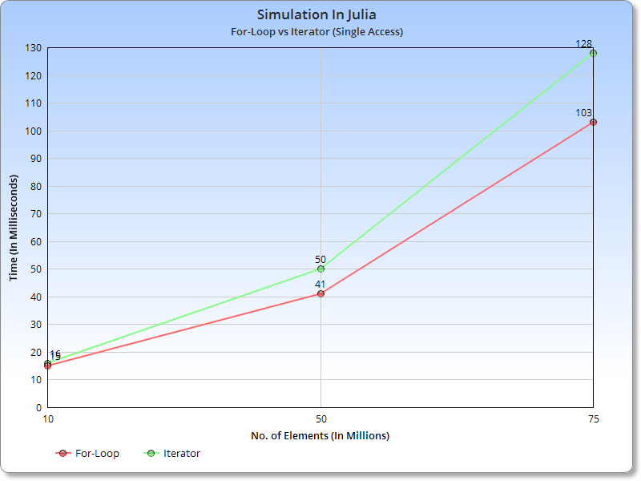
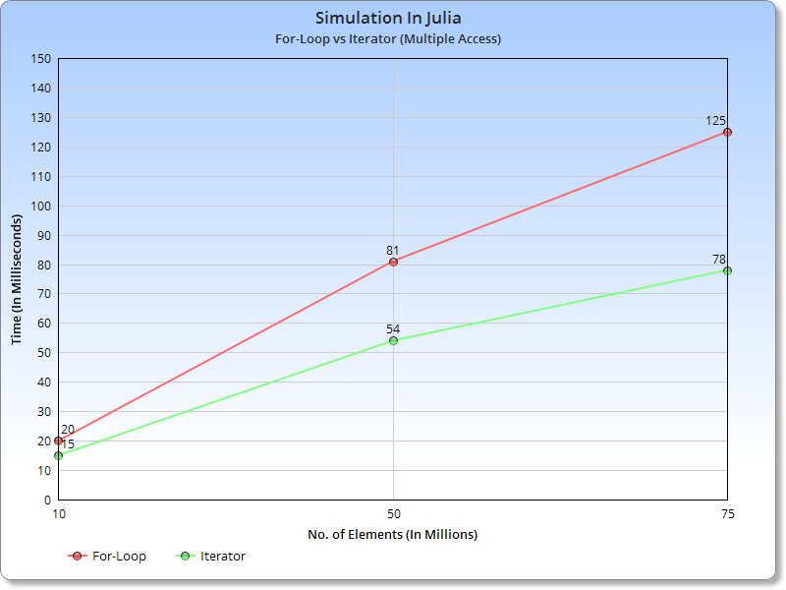
Simulation in Julia (Graphs)
Multiple Access :
new_sum = previous_sum + arrayElement + arrayElement + arrayElement + arrayElement + arrayElement
Single Access :
new_sum = previous_sum + arrayElement
For-loop is slightly faster than Iterator when the array is getting accessed only once per iteration.
If the program accesses array more than once in each Iteration then For-Loop is slower than Iterator.

Slide 11
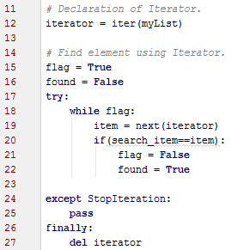
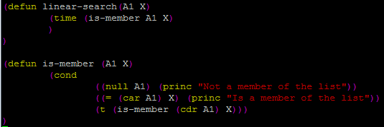
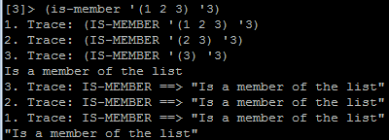
Simulation in Python and CLisp (Code)
Python: Linear Search
Uses Iterator to iterate
Clisp: Linear Search
Uses recursion to iterate
Code
Trace

Slide 12
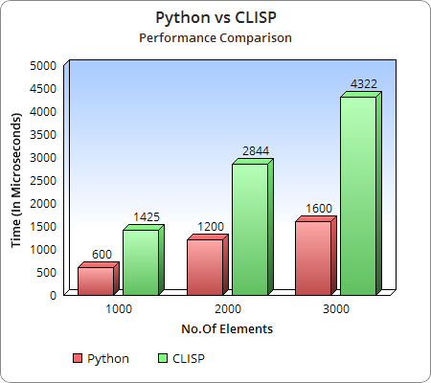
Simulation in Python and CLISP (Graph)

Slide 13
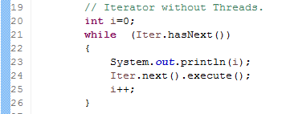
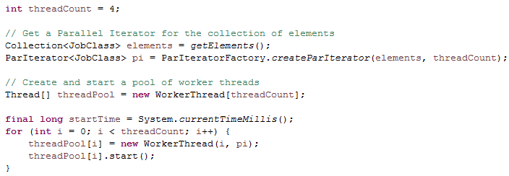
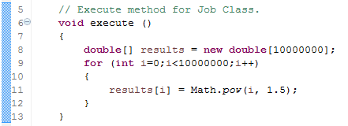
Simulation in Java using threads (Code)
Iterator with Threads
Iterator without Threads
Passing the divided job objects into their respective threads using ParIterator Library
Iterating over a set of job objects without threads
Computation Task of Job Object

Slide 14
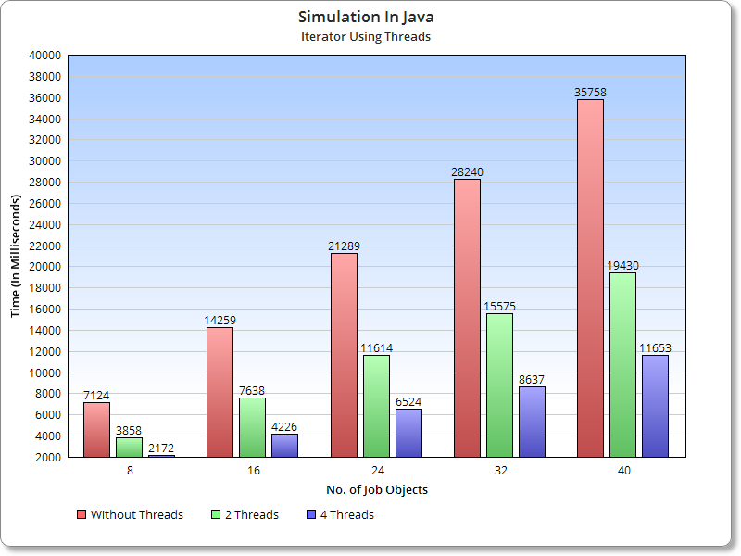
Simulation in Java using threads (Graph)

Slide 15
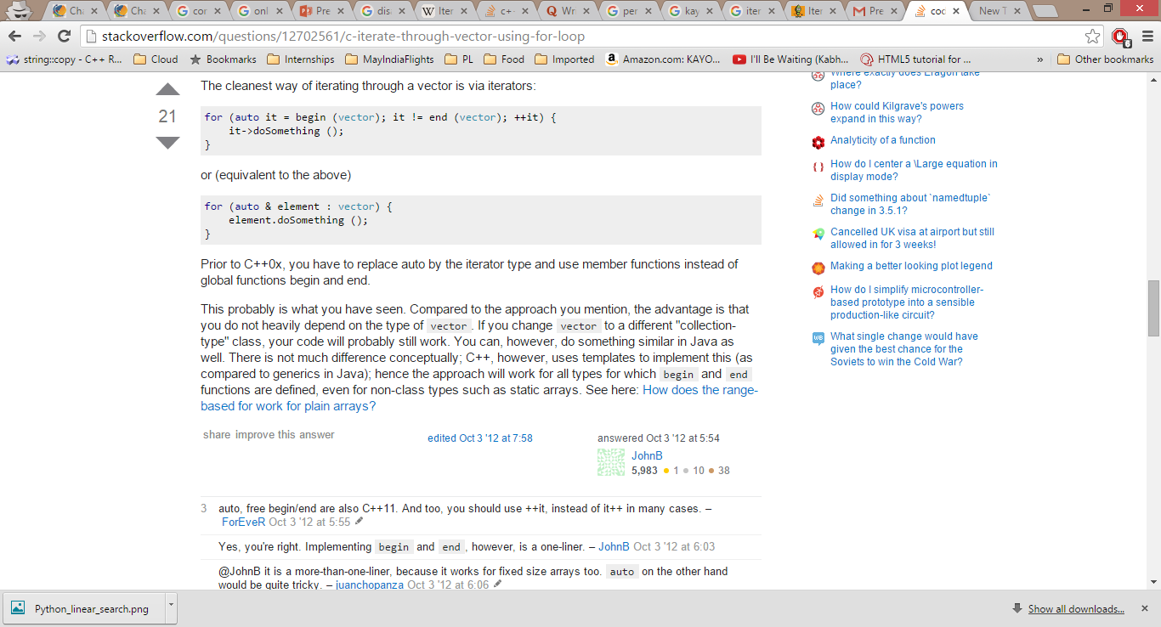
Drawbacks of Iterators
When there are dependencies amongst data structures, use of Iterators can reduce efficiency.
The structure that is being iterated can’t be updated because of the way the Iterator stores its position.
Iterators syntax may look ugly and complicated instead we can use an enhanced For-Loop.
Iterator
Enhanced For-Loop

Slide 16
References :
http://nvie.com/posts/iterators-vs-generators/
http://homepages.engineering.auckland.ac.nz/~parallel/ParallelIT/PI_API/pi/ParIterator.html
http://julialang.org/
http://www.chartgo.com/

Slide 17
Questions..?
Hopefully not too many!

